Slide 1
Exam 4 Kinetics and Electrochemistry
Grace 12/03/18

Slide 2
Chemical Kinetics
Rate of Reaction
Reaction rate= Change in concentration with respect to time, unit M*s⁻¹
Species with larger coefficient number→ consumed or produced more quickly
Reaction rate could be normalized according to stoichiometry(coefficients)
Rate laws and order
x is the order in A, y is the order in B, and Z is the order in C
Overall reaction order= x + y + z
k(lowercase): rate constant

Slide 3
Rate Law
(1) For overall reaction equation:
reaction order has nothing to do with coefficients
We cannot get rate law from overall reaction equation by directly looking at it.
(2) For elementary steps:
We can write down the rate law from the chemical equation as written.
Unimolecular steps are first order; bimolecular steps are 2nd order overall.
Rate constant k
Dependent on temperature.
Its unit could indicate the overall reaction order
0th order: k= M*s⁻¹ 1st order: k= s⁻¹ 2nd order: k= M⁻¹*s⁻¹

Slide 4
Rate Law Expression---Method of Initial Rates
How to determine empirical rate law in lab?
(1) We run several experiments and measure the rate just after the reaction begins (concentrations of each reactant known this way as initial concentrations).
(2) Select a pair of data(2 rows) where only one reactant concentration varies. By comparison, k cancels and we can determine the reaction order of that species. Repeat and find order of each species.
(3) Select any set of data(any row) and plug in the concentration numbers raised to the orders found, we can calculate rate constant k.
(4) Rate law expression found.

Slide 5

The Integrated Rate Laws
Definition: an expression of concentration vs. Time
Half life: time it takes for initial concentration to reach ½ of that value
@ t_{½} $[A]=\frac{\left[A\right]0}{2}$
”Must” memorize those! ☺

Slide 6
Reaction Mechanisms
Definition:
The elementary steps involved in a chemical reaction make up what we call a mechanism.
Net overall reaction= sum of elementary steps
Check validity of your mechanism:
The mechanism we propose will yield an overall rate law, and it must be consistent with the experimental rate law for this mechanism to be valid (even agrees, the mechanism not necessarily correct, further evidence needed.)

Slide 7
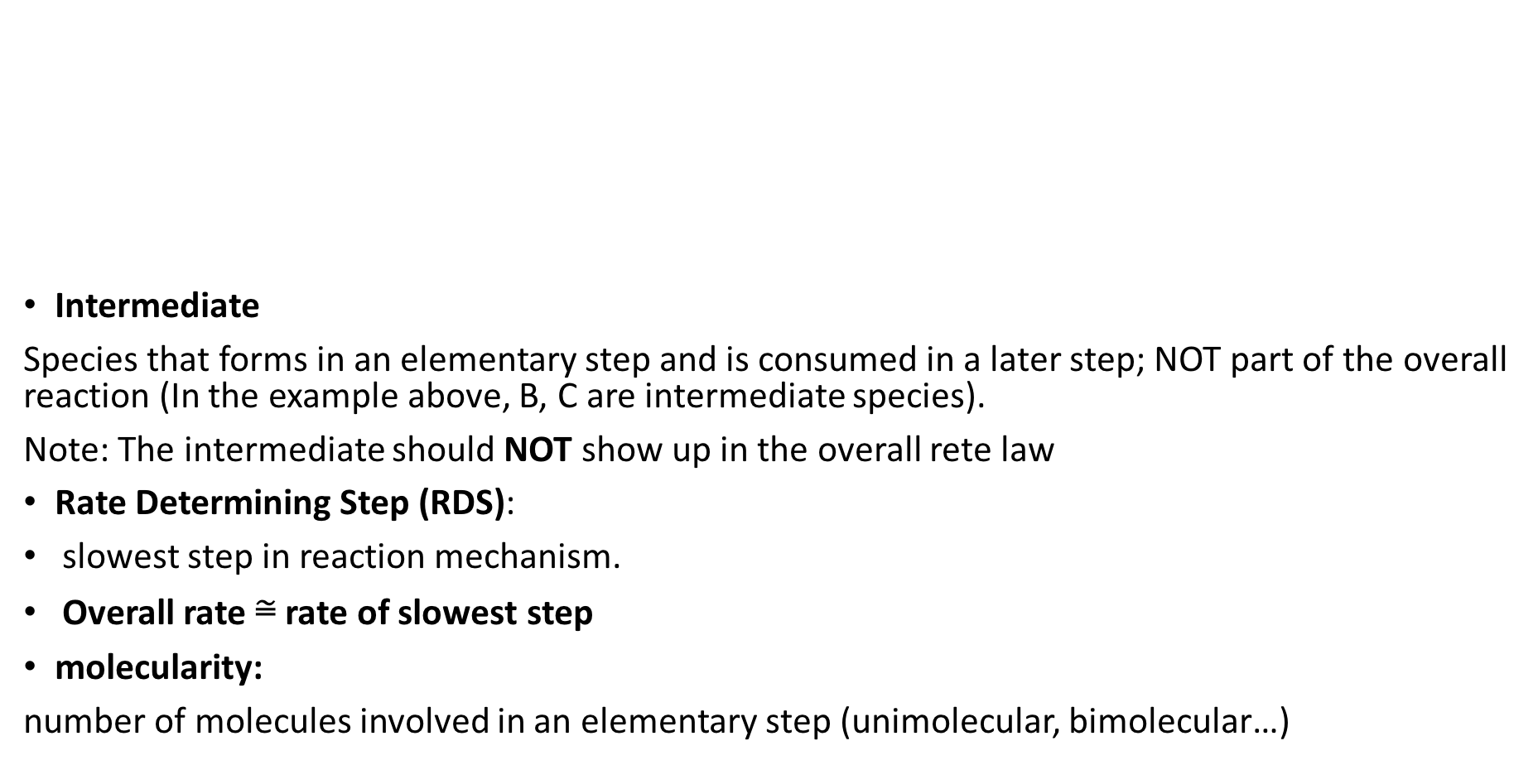
Definitions
Intermediate
Species that forms in an elementary step and is consumed in a later step; NOT part of the overall reaction (In the example above, B, C are intermediate species).
Note: The intermediate should NOT show up in the overall rete law
Rate Determining Step (RDS):
slowest step in reaction mechanism.
Overall rate ≅ rate of slowest step
molecularity:
number of molecules involved in an elementary step (unimolecular, bimolecular…)

Slide 8
Arrhenius Equation (k ~ T)
Relate rate constant and temperature
Ea: activation energy, positive number
Dr. McCord calls this the "user friendly" version:
Important! ☺

Slide 9
Ea and Catalyst
Ea Activation energy
Reaction Energy Diagram
# of humps: # of elementary steps
Highest hump → Rate determining step(RDS)
Ea activation energy (A→B): Need to get to the top and then get to B, see graph
Catalysts accelerate reaction rates by providing an alternative reaction pathway with a LOWER activation energy.

Slide 10
Electrochemistry
Reducing & Oxidizing Agents
Oxidizing agent: stealing electrons from something else. It gets reduced itself (oxidation numbers going down)
Reducing agent: provide/give out electrons to something else. It gets oxidized itself (oxidation numbers going up)
Note: oxidizing/reducing agents are not delivering electrons, they are accepting/providing electrons

Slide 11
2 Cell types
electrolytic cell:
cell containing a nonspontaneous chemical reaction. Reaction is forced to occur by applying an electrical potential.
Example: electroplating, eletrolysis
voltaic or galvanic cell
cell containing a spontaneous chemical reaction
These can be used as a source of energy.
Example: Computer, cellphone and calculator batteries (All batteries!)
How could I tell the cell type then?
By checking potential of the cell Ecell:
If Ecell= positive→ Voltaic cell
If Ecell= negative→ electrolytic cell
Important! ☺

Slide 12
E∘_{ox} is for the anode reaction. Flip the reaction taken from the table and get E∘_{ox}= –E∘
All the numbers directly taken from the table.
Should I write down the balanced the overall cell reaction, and multiply by the coefficients when using the above equations to calculate ? → Nope! No coefficients needed.
Why?
Because coefficients do not change the standard half cell potential
Example:

Slide 13
Note: This notation is applied to both voltaic and electrolytic cells.
Electrical world ⥨ chemistry world
This is wonderful! How could we use this?
1. You can be asked to calculate equilibrium constant K (most common case)
2. You can calculate Eº
3. You can calculate △Gº

Slide 14
The one you will normally use!☺

Slide 15
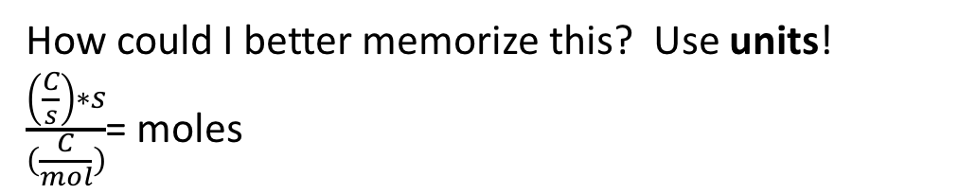
How could I better memorize this? Use units!
$\frac{\left(\frac{C}{s}\right)∗s}{(\frac{C}{mol})}$= moles

Slide 16
Examples
Preview:
#1 cell type
#2 non-standard cell potential
#3 Current stoichiometry
#4 Kinetics supplementary
*Please go back to previous reviews and check for more kinetic example problems, ALL types covered already*

Slide 17
Example #1 Cell type
Key: #5

Slide 18
Example #1 Cell type
Au⁺(aq) | Au(s) is the cathode
To determine the cell type, we need to calculate Eº cell
Since Eº cell is positive, the reaction is spontaneous, so this is a voltaic cell (a battery).
Extra: Why Eº cell=positive=spontaneous
Positive E means negative △G → spontaneous

Slide 19
Example #2 Non-standard Ecell
Key: #1

Slide 20
Example #2 Non-standard Ecell
Standard cell potential practice
The two half reactions given are all reductions, we need to find an oxidation to make a cell
Oxidation occurs at the anode Br-/Br₂, so we need to flip the first half reaction given.
standard cell potential

Slide 21
Example #2 Non-standard Ecell
Balanced overall cell reaction:
2Au⁺ + 2Br ⁻→ Br₂ + 2Au
To correct for the non-standard concentration we use the Nernst equation
Account for non-standard state
This Q expression is from the balanced overall cell reaction.
Mass action expression: coefficients= exponents
Au(s, pure solid) and Br2(l, pure liquid) →activity=1

Slide 22
Example #3 Current stoichiometry
Key: #2

Slide 23
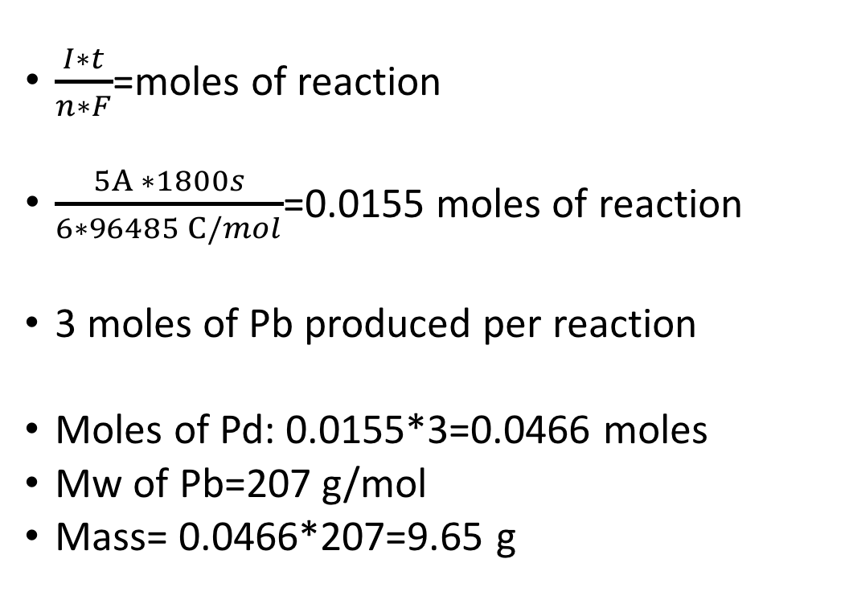
Example #3 Current stoichiometry
$\frac{I∗t}{n∗F}$=moles of reaction
$\frac{5A ∗1800s}{6∗96485 C/mol}$=0.0155 moles of reaction
3 moles of Pb produced per reaction
Moles of Pd: 0.0155*3=0.0466 moles
Mw of Pb=207 g/mol
Mass= 0.0466*207=9.65 g
Balanced cell reaction
2Al + 3Pb²⁺→ 3Pb + 2Al³⁺
n=6
Current I= 5A
Time t= 30min= 1800 s
Coulomb= A*s

Slide 24
Example #4 Kinetics
Key: #1
Catalyst is present before the reaction starts (While intermediate being produced after reaction starts )
So Pt is catalyst, Cl, ClCO are intermediates

